Slide 1
Machine Learning Chess
Peter Flockhart and Henry Johnson
CS 542

Slide 2
Introduction (FORMAL)
Chess is one of the world’s oldest games, with records of the game predating the 7th century CE.
The study of chess is rooted in game theory and probability. It has a game complexity tree of 10^(120), the Shannon number.
Finding the best move requires split-second critical thinking and analyzation, efficiency, and a knowledge of what comes ahead and what has past. You must build off of what you have done or seen before to be successful.
Machine learning allows us to solve complex problems in a much simpler way through the development of quick, deep learning and neural networks. We leave the hard work up to the machine; all we have to do is build it.

Slide 3
Why chess?
(BEGIN INFORMAL)

Slide 4
Why chess?
Chess is one of the world’s oldest games, with records of the game predating the 7th century CE.
The title of chess grandmaster is held in high regard in certain circles (of only chess players). They’re the best of the best. Can they be beat?
The study of chess is rooted in psychology, game theory, and probability. Those latter two will sound very familiar to anyone that has studied…

Slide 5
Computer Science!

Slide 6
C(hes)S
With a game complexity tree of 10^(120), the Shannon number, the task of evaluating the best move to make is daunting.
That’s where CS comes in!
Our “science of abstraction” allows us to critically think about ways to make complex problems much simpler, developing exciting new algorithms and programs to do just that.
Except we don’t want to actually do the hard work which is why this problem requires the use of…

Slide 7
Machine Learning!

Slide 8
Machine Learning
(END INFORMAL)
We leave the hard work - the training, learning, analyzation, etc. - up to the machine.
This has the potential to yield great results and give the user an upper hand when playing chess.
So, how do you beat a Grandmaster?
By….machi-ting: Using a super fast, super intelligent, super logical machine to tell you what to do.

Slide 9
Data Sets
Chess games from the 1800s to now are widely available online for free.
So much data, such little time.
Time constraints held our training data, after formatting and cleaning, to 200,000 samples, much less than the ideal one- to ten-million.

Slide 10
Neural Network
Constructed using Keras Sequential model on top of TensorFlow.
Supervised learning
Two models
Model 1: Piece Count
Model 2: Piece Position

Slide 11
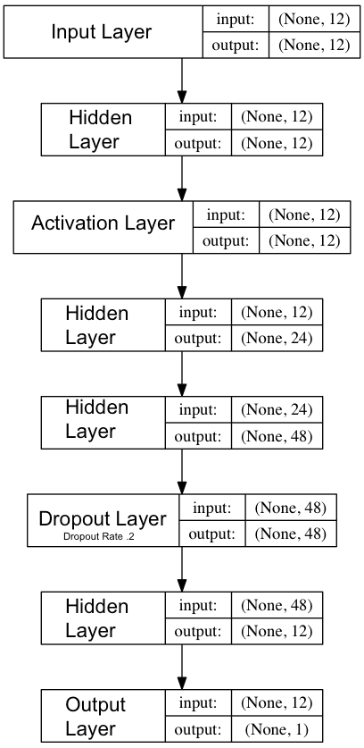
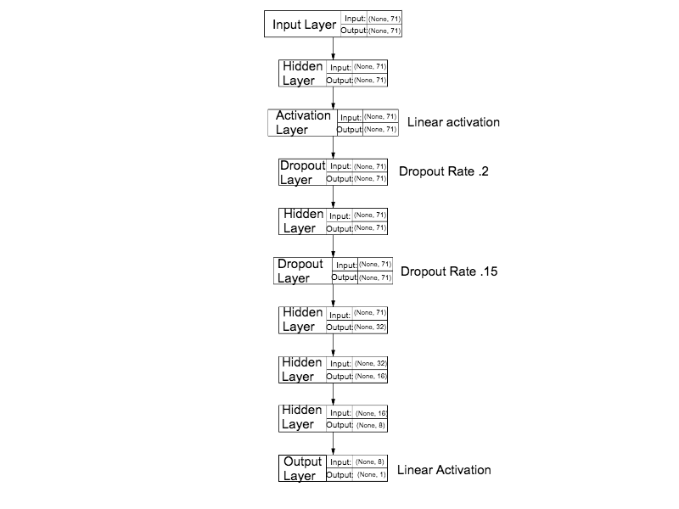
Structure
Note: Unless otherwise stated, the activation function of each layer is tanh.
Model 1: Piece Count
Model 2: Piece Position

Slide 12
Input
Model 1: Piece Count
12 nodes; each node represents the number of each type of piece on the board.
e.g. 1 black bing, 2 white rooks, etc
Model 2: Piece Position
71 nodes;
first 64 nodes represent each square of the board with a value corresponding to the piece at that location
last 5 nodes represent castling rights, check/checkmate, and the turn

Slide 13
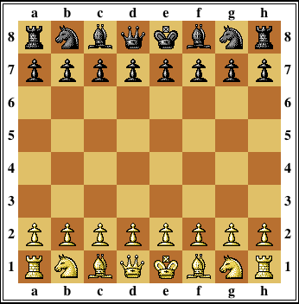
Board/Input
EPD: rnbqkbnr/pppppppp/0/0/0/0/PPPPPPPP/RNBQKBNR w

Slide 14
Output
Use of tanh activation function required scaling of output between -1 and 1
Output: Evaluation of chess board
Best Move: Move with max/min score on chess board
closer to 1 is good for white, -1 is good for black

Slide 15
Evaluation
Metrics for success (testing against traditional chess engine):
Time: How quickly can the model make predictions?
Accuracy: What percent of the time is the best move picked?

Slide 16
Metric: Time (Both Models)
One position in 3 millionths of a second.
Much faster than a traditional chess engine.
High accuracy per unit time

Slide 17
Metric: Accuracy, Piece Count
Best Move Prediction is ~three and a half times as good as random guessing (average 7%).
Best Move in Top Three Prediction has average of 18%, just over twice as much as Best Move.
Drop off with layer reduction.
most effective model had 5 hidden layers

Slide 18
Metric: Accuracy, Piece Position
Best Move Prediction is two times as good as random guessing (average 4.5%).
Best Move in Top Three Prediction has average of 10.66%, twice as much as Best Move.

Slide 19
Metric: Accuracy
Note: Error of model is only relevant among many samples, not just one because you need to know strength of a position relative to other positions.

Slide 20
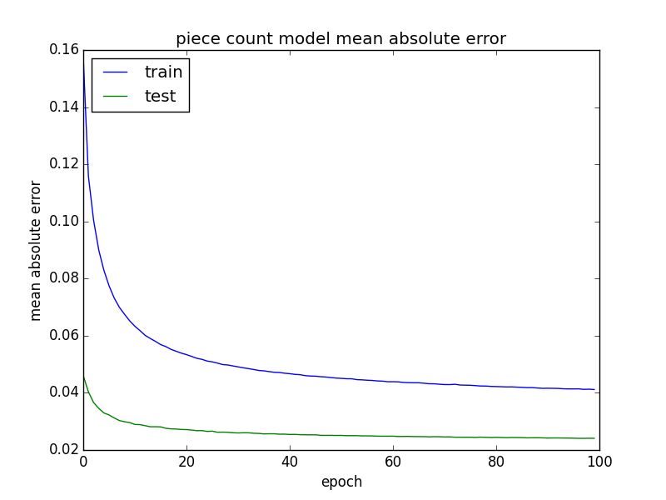
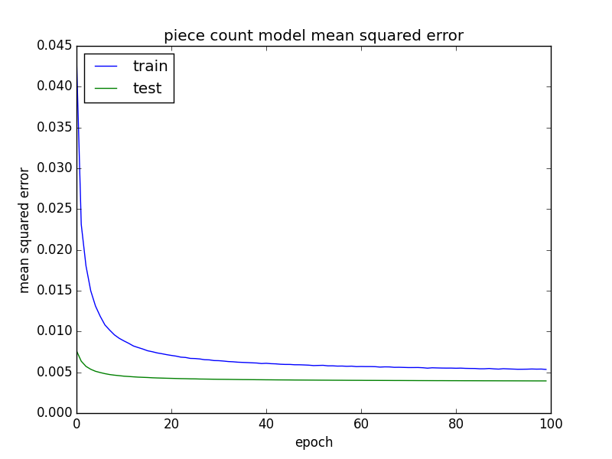
Evaluation: Piece Count Graphs

Slide 21
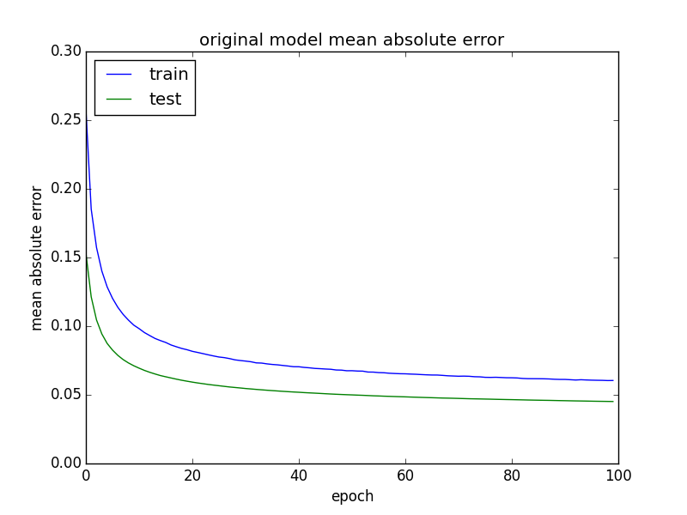
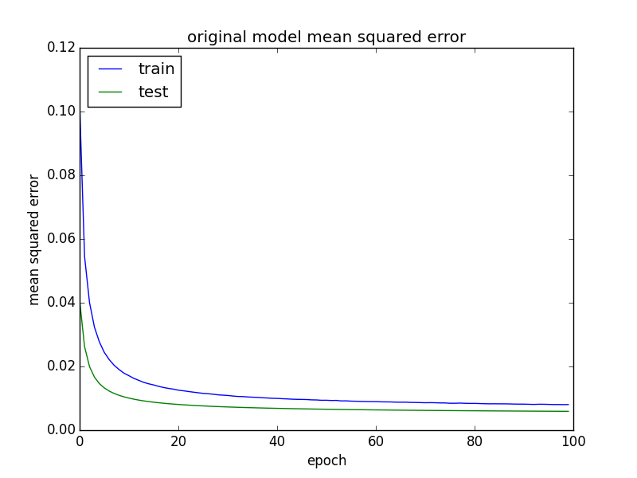
Evaluation: Piece Position Graphs

Slide 22
Conclusion
While accuracy/time is good, and the Best Move is chosen an acceptable amount, the Best Move in Top 3 metric is below an acceptable rate, an ideal of >20%.
Better position evaluation time when generating data (>1 sec.) could yield better testing data
Bigger data set run for longer time could produce better metrics for Best Move and Top 3.

